Slide 1
Sending data from sensors to clouds
By:
Nikitha Sharma
Sakshi Vattikuti
Triambaka Naresh

Slide 2
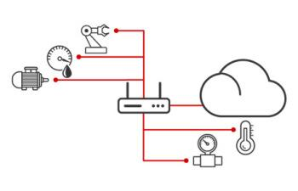
An overview
The main aim of the project was to send data from sensors to cloud.
This enables one to keep track of data as and when it changes. Real-time data helps in monitoring values and ensuring timely prevention in case something goes wrong.
Multiple sensors are connected to Arduino or Node MCU. As and when the sensors sense a new value they are sent to the real-time database and this data is retrieved from the cloud (in our case Firebase) with the help of a HTML page. This data can be viewed on a mobile friendly app.

Slide 3
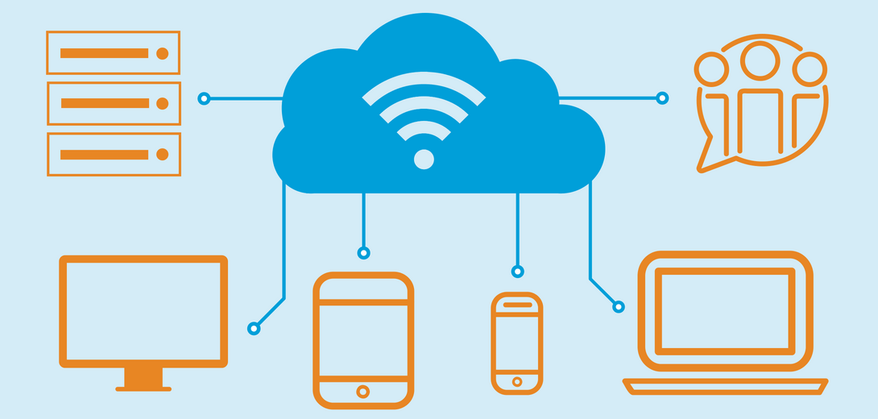
Cloud
Cloud computing is the on-demand availability of computer system resources, especially data storage and computing power, without direct active management by the user.
Users can scale services to fit their needs, customize applications and access cloud services from anywhere with an internet connection.

Slide 4
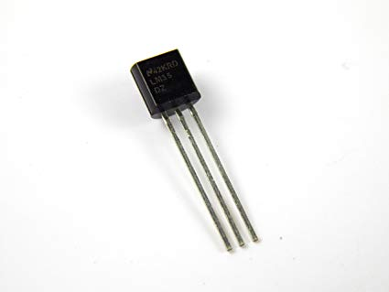
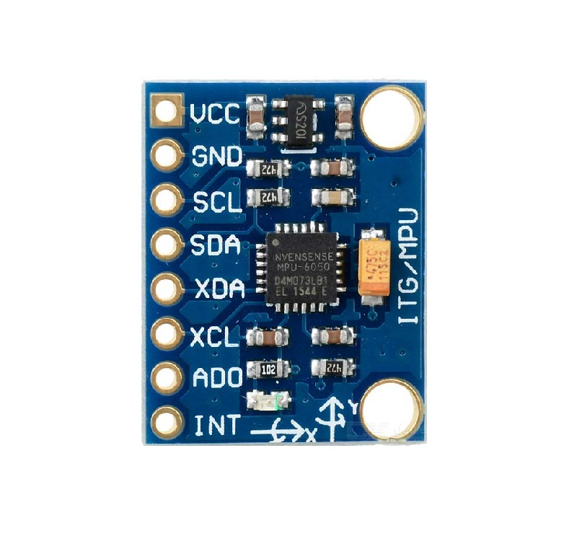
Few sensors which can be used
1.Temperature sensor LM35 :
2.Accelerometer MPU6050 :

Slide 5
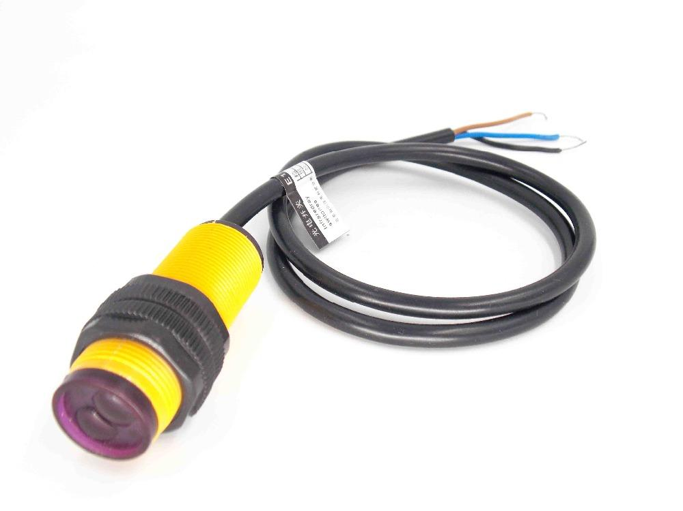
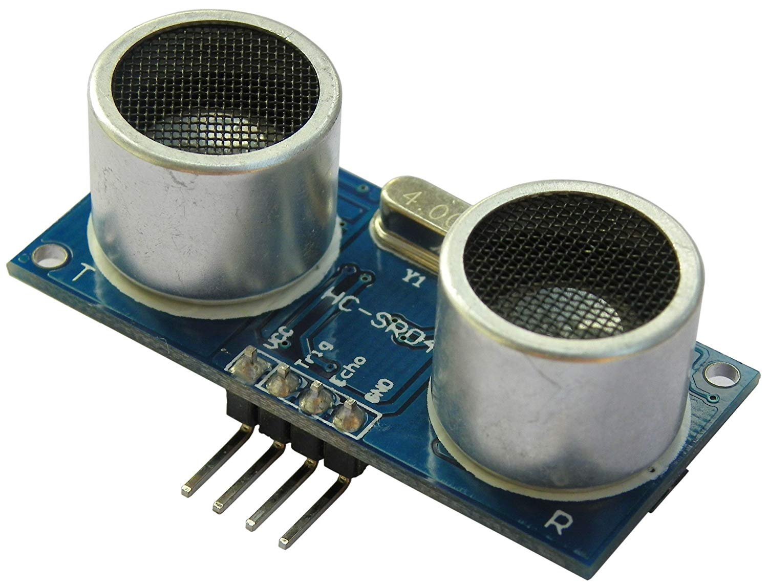
3.IR Sensor :
4.Ultrasonic Sensor:

Slide 6
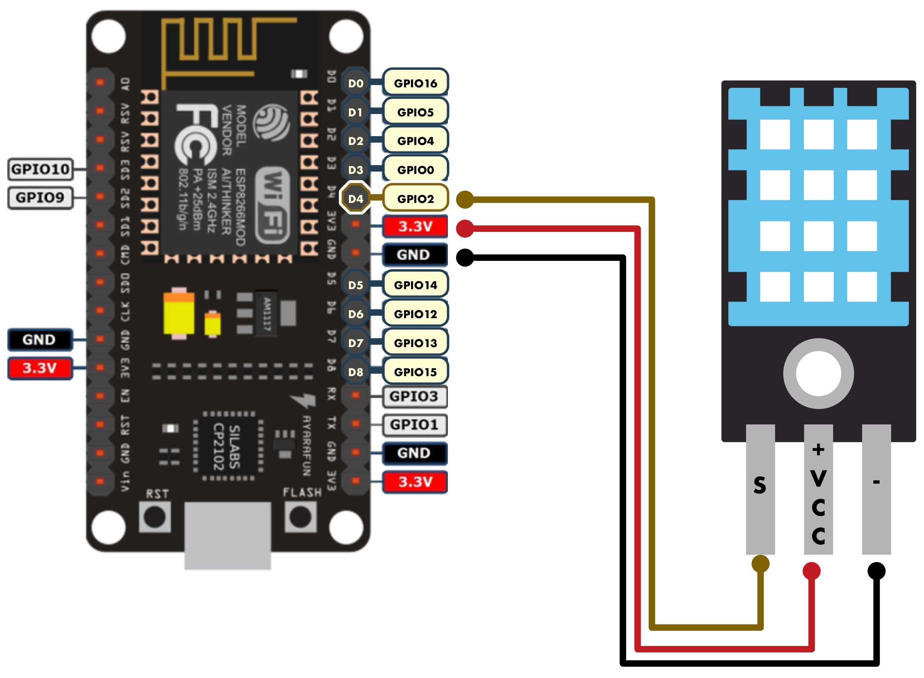
Temperature sensor
Working principle: Increase in resistance increases the temperature
They are precision integrated-circuit temperature sensors,whose output voltage is linearly proportional to the Celsius temperature.

Slide 7
Connections
Vout of four temperature sensors are connected to A0 pin of the Node MCU using 4:1 4051 multiplexer.
Inhibit , ground and VEE are connected to ground of Node MCU
VCC of mux is connected to 3.3 V.
The selection lines can be connected to any of the digital pins.

Slide 8
How it works?
The temperature sensor transmits data to firebase as and when it detects changes. Firebase records this data in the real-time database.
This change is retrieved by the HTML page in the form of snapshots.
This HTML is then styled and is converted to a mobile- friendly app.
Another feature is that the maximum temperature is also noted.

Slide 9
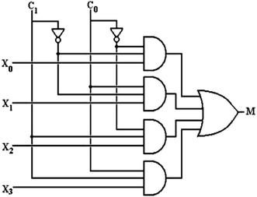
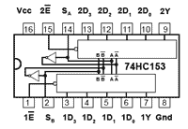
MULTIPLEXER
Since this model had to be used with multiple sensors which all required to be connected to an analog point which wasn't available, a 4:1 multiplexer was used.
This enables multiple sensors to be connected to the node MCU at the same time.

Slide 10
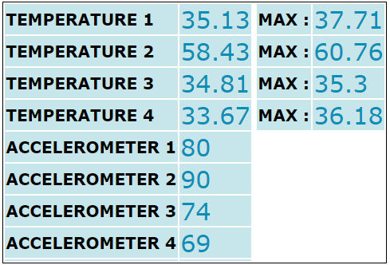
The App

Slide 11
Thank you!!

